Slide 1
FLAX Weaving with Oxford Open Educational Resources
Alannah Fitzgerald

Slide 2
Overview
Oxford-managed and -created content in FLAX (The Flexible Language Acquisition project)
Research corpora & Teaching podcasts
OpenSpires project at Oxford
Creative commons-licensed content
Building language collections in FLAX with OER
Linking to open linguistic tools and content
Creating interactivity in your collections

Slide 3
Collocation
database
Digital Library
Any other resource
Glossary
Notes:
Teachers can construct collections of different types: for different purposes and for different types of students.
The collections can be:
item specific
domain and/or topic specific
graded for levels of difficulty
representative of a particular source or of a particular genre
subsets of a larger corpus e.g. BAWE.
Potentially students can also construct collections (see Charles, 2012)

Slide 4
flax.nzdl.org

Slide 5
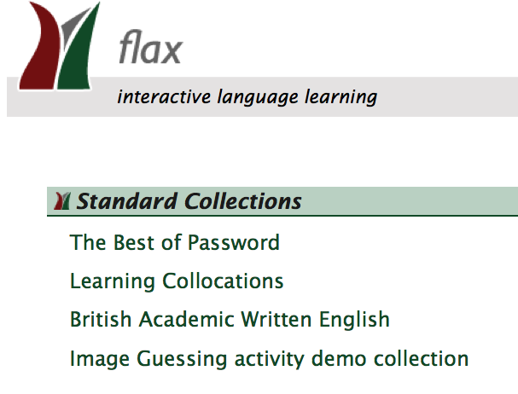
BNC/BAWE

Slide 6
Learning Collocations collection in FLAX FLAX team collections building: Shaoqun Wu, Ian Witten, Margaret Franken, Xiaofeng Yu – Waikato University

Slide 7
Learning Collocations in FLAX: in response to ‘where are the good published collocations resources?’
Research shows that the successful use of collocations in student writing and speaking supports not only improved levels of accuracy but also improved levels of fluency in their use of English (Wray, 2002; Nesselhauf, 2003).
Constraints with published collocations resources
Publication issues = the number and specificity of collocations examples that can be assigned to print and CD-ROM formats.

Slide 8
British Academic Written English corpus: browse by genre or discipline

Slide 9
The BAWE collections in FLAX: moving away from mutt genres with digitally enhanced and authentic genres
“ ‘mutt genres’—genres that do not respond to rhetorical situations requiring communication in order to accomplish a purpose that is meaningful to the author” (Wardell, 2009).
“Unsurprisingly, the utility of the corpus is increased when it has been annotated, making it no longer a body of text where linguistic information is implicitly present, but one which may be considered a repository of linguistic information.” (ICT4LT, Module 3.4 Corpus Linguistics http://www.ict4lt.org/en/en_mod3-4.htm)

Slide 10
BAWE sub corpus wordlists

Slide 11
The BAWE sub corpus text collections: POS-tagging phrases

Slide 12
Search and store collocations

Slide 13
Retrieve and save collocations

Slide 14
Collocational links to further resources

Slide 15
Wikify key words & phrases

Slide 16
Word lists: general, academic, specific, key

Slide 17
How could you use the FLAX collections in your teaching and learning?
Notes:
70 ninutes

Slide 18
University of Oxford OER
http://openspires.oucs.ox.ac.uk/resources/index.html#posters
Notes:
Well-resourced – ou – ebooks, lectures and more – not able to identify individuals as made by teams
Podcasts – oxford – 40% cc – highlighting stars
China – Nottingham – campus at Ningbo instead of having to use youtube which is blocked uNow
Representing the ethos of the institutions
The best marketing is great learning material – Martin Bean

Slide 19
Notes:
A new method of giving individual items individual licenses in the metadata is apparently on its way

Slide 20
“In the late 19th century Oxford was one of the pioneers of the university extension movement, which enabled audiences around the UK to hear what some of its lecturers had to say on a wide range of topics. The OpenSpires project is the 21st century equivalent, though, with the benefit of the web, the audiences are now global and we hope even more diverse. It is a pleasure to contribute to this important venture, which is opening up Oxford like never before”.
(McDonald, n.d.)

Slide 21
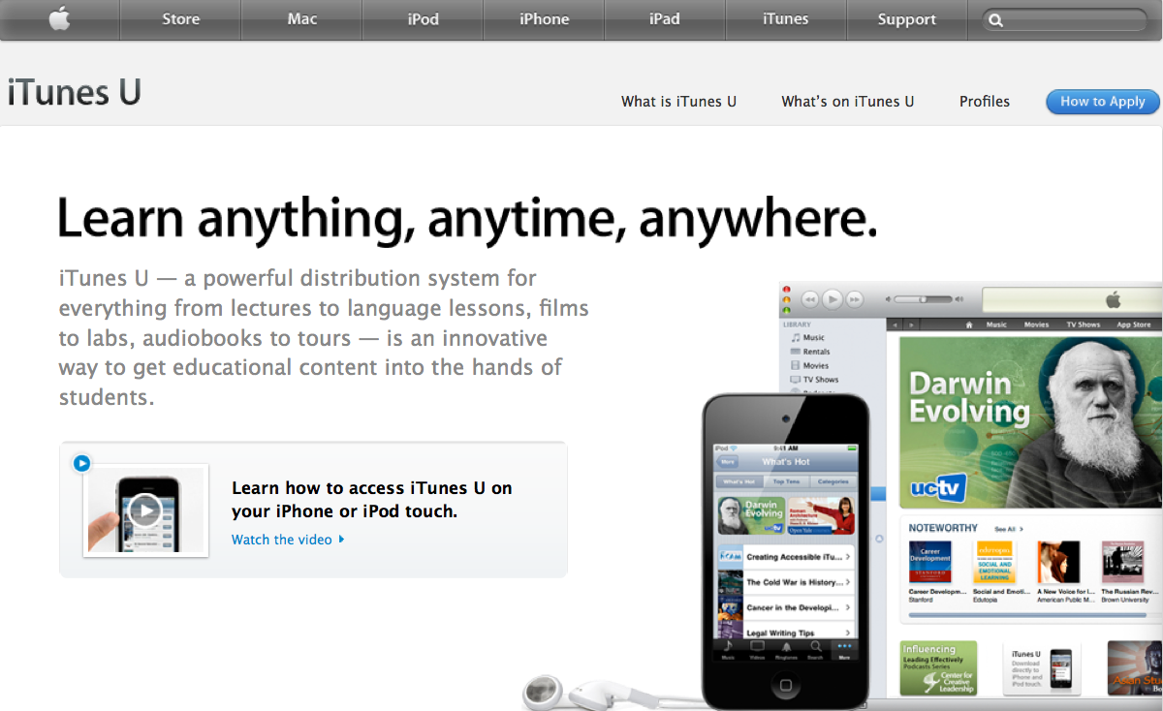
http://www.apple.com/education/itunes-u/

Slide 22
It’s all in the downloads
University | Downloads
Open University, UK | Over 34 million since June 2008
University of Oxford | Over 9 million since June 2008
Coventry University | 2.5 million in 2010 alone
University of Warwick | 1 million Jan ‘09 – June ‘10

Slide 23
English OER through literature

Slide 24
Great Writers Inspire
http://writersinspire.org/

Slide 25
What could you do with the Oxford Creative Commons podcast content?
Notes:
70 ninutes

Slide 26
Linking open tools and open pods
http://http://openspires.oucs.ox.ac.uk/crunch/
Notes:
Ylva –OER mash-up for language learning
Do we want to say something about discipline-spec discourse types in uni lectures/seminars? Turn taking in uni seminars – uni of Birmingham – looking at different knowledge domains – something I saw at CLC in B’ham in July
E.g. medical seminars – long turn from sts presenting case studies with input from tutor and other sts at the end. Hard sciences have a lot more stop and check the facts built into exchanges btwn sts and tutors -

Slide 27
OpenSpires in FLAX

Slide 28
Mining Oxford podcasts

Slide 29
Mining & linking key collocations

Slide 30
Language Teachers:
OER creators, users, re-mixers and publishers

Slide 31
Developing podcast activities in FLAX

Slide 32
Close exercises in FLAX

Slide 33
YouTube in FLAX

Slide 34
Scrambled sentences in FLAX

Slide 35
Drag ‘n’ Drop exercises in FLAX

Slide 36
Please register with FLAX to build your own collections!
http://www.flickr.com/photos/dopey/6273168640/

Slide 37
Thank you
Email: fitzgerald@education.concordia.ca; shaoqun@waikato.ac.nz
FLAX Language: flax.nzdl.org; Twitter: @AlannahFitz
Slideshare:http://www.slideshare.net/AlannahOpenEd/
Blog: Technology for Open English – Toying with Open E-resources www.alannahfitzgerald.org

